Slide 1
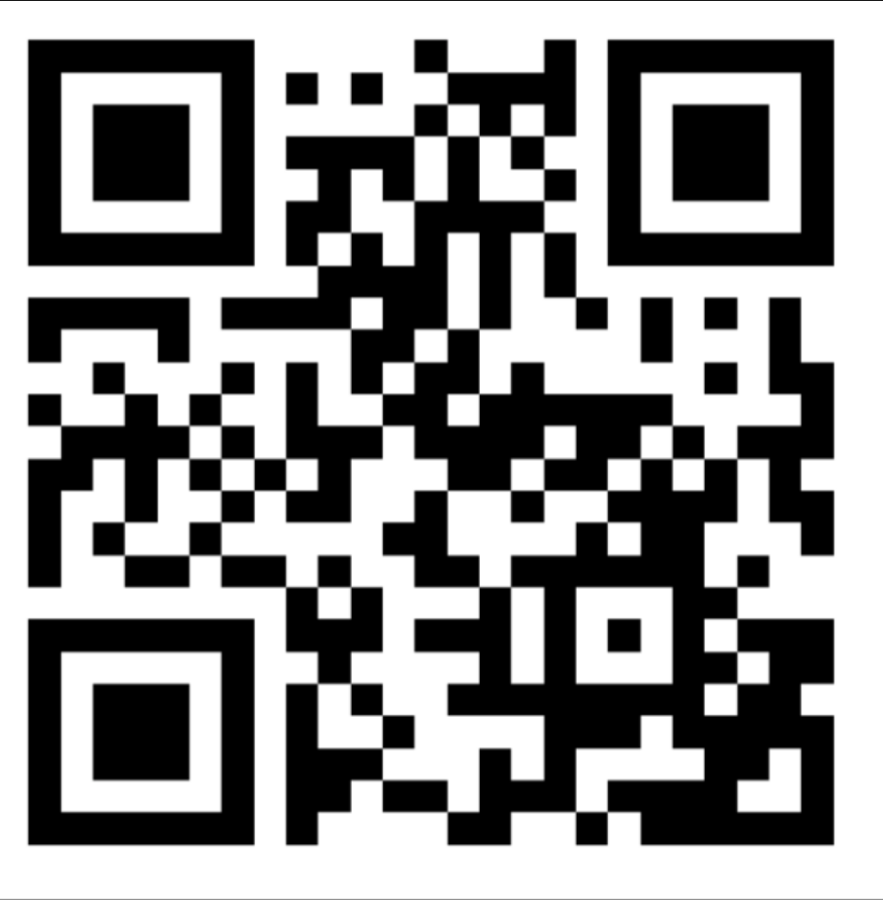
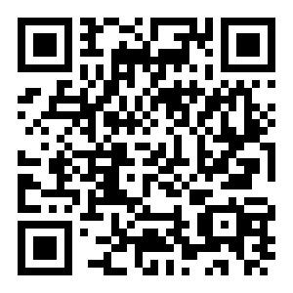

Welcome to GAI
Discord
RSVP for next meeting
Instagram
Reddit AITA Generator
https://z.umn.edu/gai-project3

Slide 2
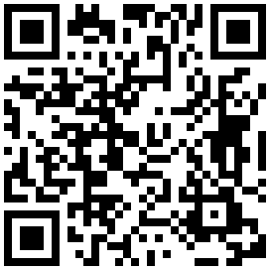
Announcement
Looking for new officers, anyone interested in leading the club next year!
Fill out this interest form (https://z.umn.edu/officer-interest)
Feel free to contact us with the club email (gai@umn.edu) or on discord, or just talk to us in person!

Slide 3
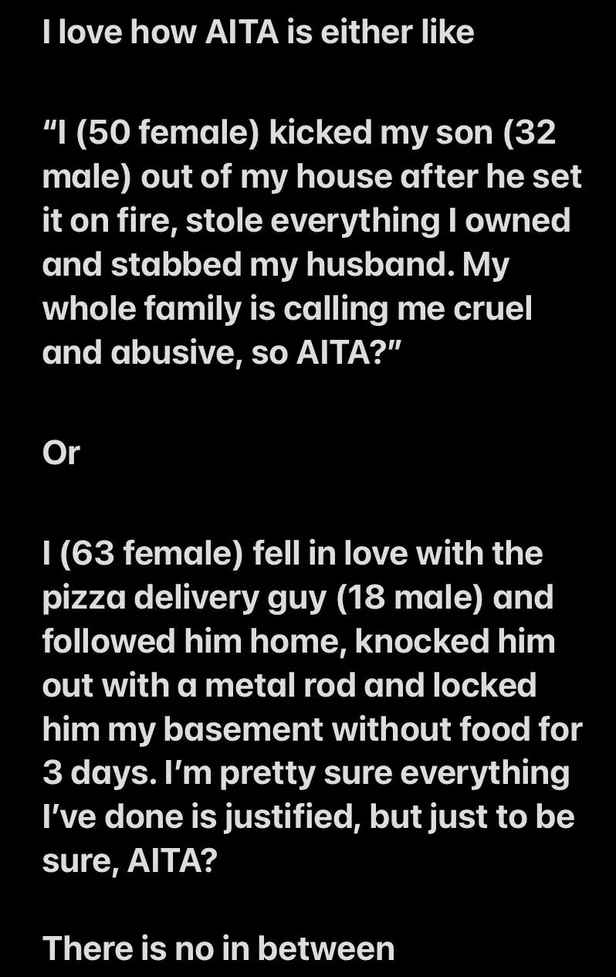

Schedule
Listen to Robert & Food
Project Intro
Run code
While training, learn about models uses & code
Fun generation time!!

Slide 4
Project Overview
Reddit AITA Generator
Will make stories for us that resemble AITA posts!
Dataset: https://www.kaggle.com/datasets/oliverposewitz/reddit-raita-post-and-comments/data
Can leverage any of the models available at https://huggingface.co/unsloth (in this case, we will be using DeepSeek-R1-Distill-Llama-8B)

Slide 5
Food and socialize
Come talk to me if you don’t have an API key set up yet, or if you have difficulties setting up your environment

Slide 6
Environment Setup

Slide 7
Pre-Requisites
https://z.umn.edu/gai-aita-code
REMINDER: MAKE A COPY BEFORE EDITING SO THAT YOUR CHANGES WILL BE SAVED

Slide 8
Let’s get Started!!

Slide 9
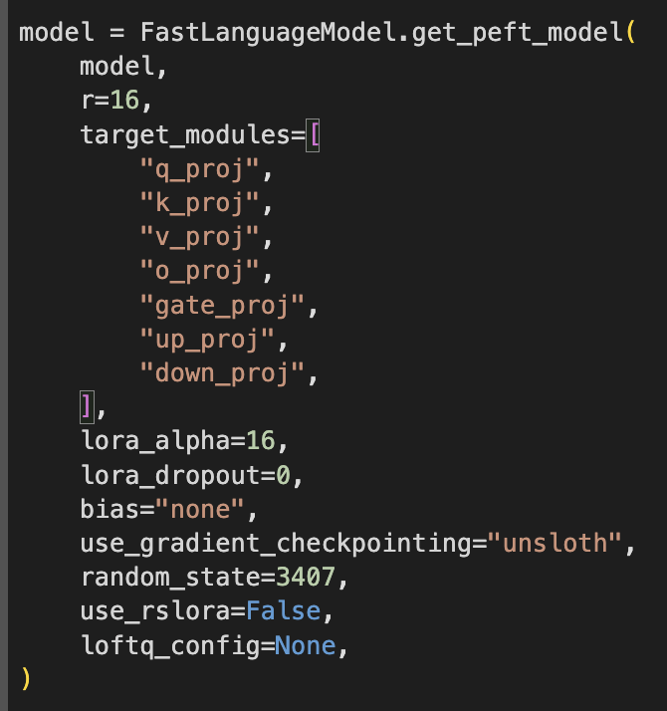
Techs Used
Unsloth: Reduces training time, memory usage (otherwise our Collab would die).
SFTTrainer: Supervised fine-tuning trainer (provided by HuggingFace).
PEFT: Parameter-efficient fine-tuning.
LoRA: Low-rank adaptation; A way to adapt a large machine learning model for specific uses without retraining the entire model.

Slide 10
What we now have
A fast and low-RAM fine-tuned DeepSeek-based model for AITA story generation
The model uses modern, GPU-optimized types like bfloat16 for faster computation

Slide 11
THANK YOU!

Slide 12
RSVP for Next Meeting
https://z.umn.edu/gai-project3

